Slide 1
Data Mining

Slide 2
About Myself
Contact Details
Room: 28
Email: mghouri@numl.edu.pk
Contact Hours: Mon 8:00 AM – 1:00 PM
Notes:
2
2

Slide 3
Textbook
Han, J., Kamber , M., & Pei, J. “Data Mining: Concepts and Techniques”, Latest Edition, Morgan Kaufmann

Slide 4
Evaluation Criteria
Subject to change as per policy
Activity | Evaluation Percentage
Assignments | 15
Quizzes | 10
Project | 10
Mid Term | 25
End Term | 40
Notes:
4
4

Slide 5
Chapter 1. Introduction
Why Data Mining?
What Is Data Mining?
A Multi-Dimensional View of Data Mining
What Kinds of Data Can Be Mined?
What Kinds of Patterns Can Be Mined?
What Kinds of Technologies Are Used?
What Kinds of Applications Are Targeted?
Major Issues in Data Mining

Slide 6
Why Data Mining?
The Explosive Growth of Data: from terabytes to petabytes
Data collection and data availability
Automated data collection tools, database systems, Web, computerized society
Major sources of abundant data
Business: Web, e-commerce, transactions, stocks, …
Science: Remote sensing, bioinformatics, scientific simulation, …
Society and everyone: news, digital cameras, YouTube
We are drowning in data, but starving for knowledge!
“Necessity is the mother of invention”—Data mining—Automated analysis of massive data sets

Slide 7
Chapter 1. Introduction
Why Data Mining?
What Is Data Mining?
A Multi-Dimensional View of Data Mining
What Kinds of Data Can Be Mined?
What Kinds of Patterns Can Be Mined?
What Kinds of Technologies Are Used?
What Kinds of Applications Are Targeted?
Major Issues in Data Mining
A Brief History of Data Mining and Data Mining Society
Summary

Slide 8
What Is Data Mining?
Data mining (knowledge discovery from data)
Extraction of interesting (non-trivial, hidden, previously unknown and potentially useful) patterns or knowledge from huge amount of data
Alternative names
Knowledge discovery (mining) in databases (KDD), knowledge extraction, data/pattern analysis, data archeology, data dredging, information harvesting, business intelligence, etc.
Watch out: Is everything “data mining”?
Simple search and query processing
(Deductive) expert systems

Slide 9
Knowledge Discovery (KDD) Process
Knowledge
This is a view from typical database systems and data warehousing communities
Data mining plays an essential role in the knowledge discovery process
Pattern Evaluation
Data Mining
Task-relevant Data
Data Warehouse
Selection
Data Cleaning
Data Integration
Databases

Slide 10
Example: A Web Mining Framework
Web mining usually involves
Data cleaning
Data integration from multiple sources
Warehousing the data
Data cube construction
Data selection for data mining
Data mining
Presentation of the mining results
Patterns and knowledge to be used or stored into knowledge-base

Slide 11
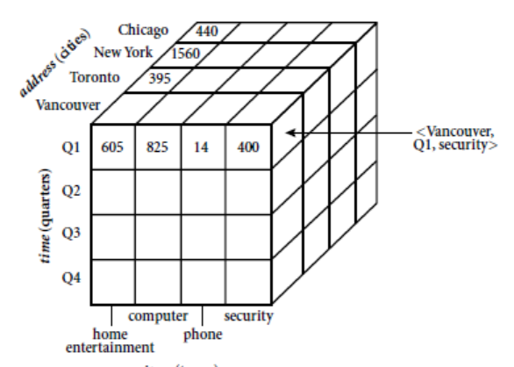
Data Cube

Slide 12
Data Mining in Business Intelligence
Increasing potential
to support
business decisions
End User
Decision Making
Data Presentation
Business
Analyst
Visualization Techniques
Data Mining
Data
Analyst
Information Discovery
Data Exploration
Statistical Summary, Querying, and Reporting
Data Preprocessing/Integration, Data Warehouses
Data Sources
DBA
Paper, Files, Web documents, Scientific experiments, Database Systems

Slide 13
KDD Process: A View from ML and Statistics
Pattern
Information
Knowledge
Input Data
Data Pre-Processing
Data Mining
Post-Processing
Data integration
Normalization
Feature selection
Dimension reduction
Pattern discovery
Classification
Clustering
Outlier analysis
… … … …
Pattern evaluation
Pattern selection
Pattern interpretation
Pattern visualization
This is a view from typical machine learning and statistics communities

Slide 14
Chapter 1. Introduction
Why Data Mining?
What Is Data Mining?
A Multi-Dimensional View of Data Mining
What Kinds of Data Can Be Mined?
What Kinds of Patterns Can Be Mined?
What Kinds of Technologies Are Used?
What Kinds of Applications Are Targeted?
Major Issues in Data Mining
A Brief History of Data Mining and Data Mining Society
Summary

Slide 15
Multi-Dimensional View of Data Mining
Data to be mined
Database data (extended-relational, object-oriented, heterogeneous), data warehouse, transactional data, stream (e.g. video), spatiotemporal (e.g. maps), time-series and sequence (e.g. stock), text (customer sentiment) and web, multi-media, graphs & social and information networks
Knowledge to be mined (or: Data mining functions)
Characterization (summarization of general features of a target class. E.g. characteristics of software products whose sales were increased by 10% last year)
Discrimination (comparison of features of contrasting classes. Eg. Comparing features of dataset where software were increased by 10% Vs. which were decreased by 30%)
Association, classification, clustering, trend/deviation, outlier analysis
Descriptive (characterize properties of data) vs. predictive data mining (predictions)

Slide 16
Multi-Dimensional View of Data Mining
Techniques utilized
Data-intensive, data warehouse (OLAP), machine learning, statistics, pattern recognition, visualization, high-performance, etc.
Applications adapted
Retail, telecommunication, banking, fraud analysis, bio-data mining, stock market analysis, text mining, Web mining, etc.

Slide 17
Chapter 1. Introduction
Why Data Mining?
What Is Data Mining?
A Multi-Dimensional View of Data Mining
What Kinds of Data Can Be Mined?
What Kinds of Patterns Can Be Mined?
What Kinds of Technologies Are Used?
What Kinds of Applications Are Targeted?
Major Issues in Data Mining
Summary

Slide 18
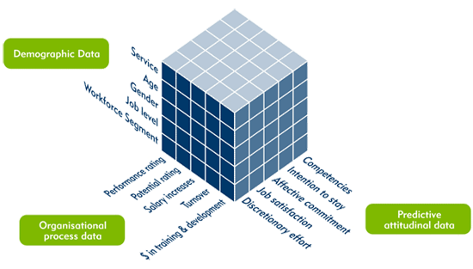
Data Mining Functions: (1) Generalization
Information integration and data warehouse construction
Data cleaning, transformation, integration, and multidimensional data model
Data cube technology
Multidimensional aggregates
OLAP (online analytical processing)
Multidimensional concept description: Characterization and discrimination
Generalize, summarize, and contrast data characteristics, e.g., dry vs. wet region

Slide 19
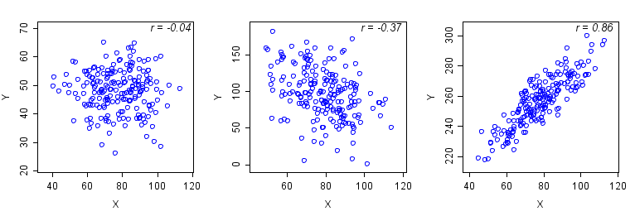
Data Mining Functions: (2) Pattern Discovery
Frequent patterns (or frequent itemsets)
What items are frequently purchased together in your Walmart?
Association and Correlation Analysis
A typical association rule
Diaper → Juice [0.5%, 75%] (support, confidence) (P(XUY),P(X|Y) )
How to mine such patterns and rules efficiently in large datasets?
How to use such patterns for classification, clustering, and other applications?

Slide 20
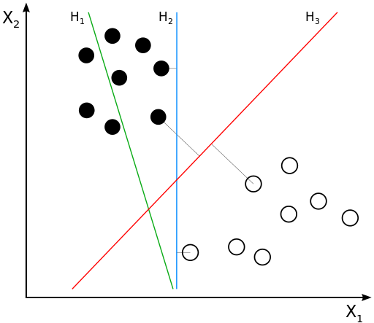
Data Mining Functions: (3) Classification
Classification and label prediction
Construct models (functions) based on some training examples
Describe and distinguish classes or concepts for future prediction
Ex. 1. Classify countries based on (climate)
Ex. 2. Classify cars based on (gas mileage)
Predict some unknown class labels
Typical methods
Decision trees, naïve Bayesian classification, support vector machines, neural networks, rule-based classification, pattern-based classification, logistic regression, …
Typical applications:
Credit card fraud detection, direct marketing, classifying diseases, web-pages, …

Slide 21
Data Mining Functions: (4) Cluster Analysis
Unsupervised learning (i.e., Class label is unknown)
Group data to form new categories (i.e., clusters), e.g., cluster houses to find distribution patterns
Principle: Maximizing intra-class similarity & minimizing interclass similarity
Many methods and applications
Like market segmentation, community detection, improving search results, ...

Slide 22
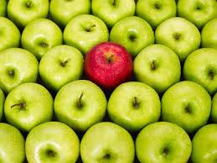
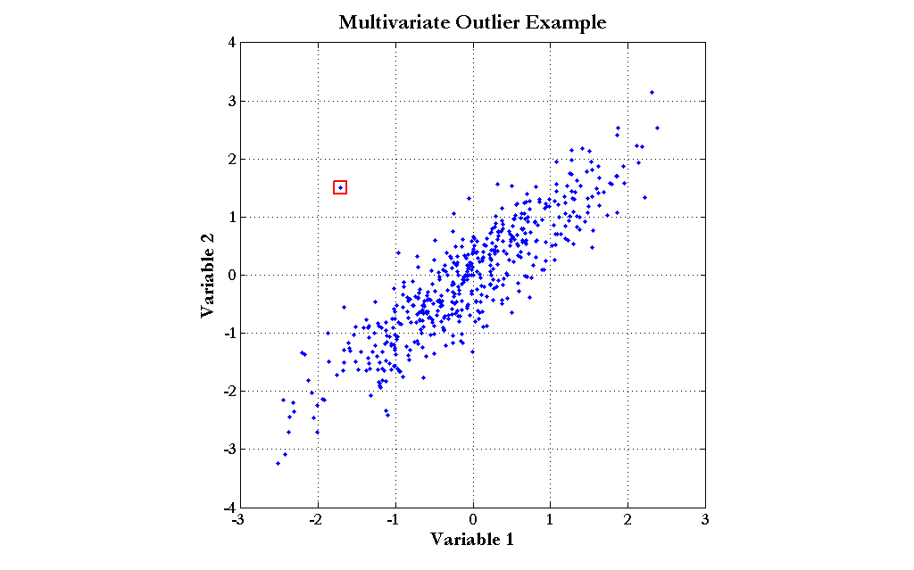
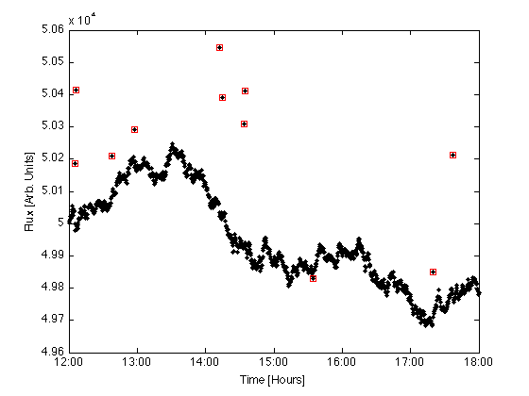
Data Mining Functions: (5) Outlier Analysis
Outlier analysis
Outlier: A data object that does not comply with the general behavior of the data
Noise or exception?―One person’s garbage could be another person’s treasure
Methods: by product of clustering or regression analysis, …
Useful in fraud detection, rare events analysis

Slide 23

Evaluation of Knowledge
Are all mined knowledge interesting?
One can mine tremendous amount of “patterns”
Some may fit only certain dimension space (time, location, …)
Some may not be representative, may be temporary, …
Evaluation of mined knowledge
Descriptive vs. predictive
Coverage
Typicality vs. novelty
Accuracy
Relevance
…

Slide 24
Chapter 1. Introduction
Why Data Mining?
What Is Data Mining?
A Multi-Dimensional View of Data Mining
What Kinds of Data Can Be Mined?
What Kinds of Patterns Can Be Mined?
What Kinds of Technologies Are Used?
What Kinds of Applications Are Targeted?
Major Issues in Data Mining
Summary

Slide 25
Data Mining: Confluence of Multiple Disciplines
Machine
Learning
Pattern
Recognition
Statistics
Applications
Data Mining
Visualization
Algorithm
Database
Technology
High-Performance
Computing

Slide 26
Why Confluence of Multiple Disciplines?
Tremendous amount of data
Algorithms must be scalable to handle big data
High-dimensionality of data
May have tens of thousands of dimensions
High complexity of data
Data streams and sensor data (temp, humidity, air pressure, gps, heart rate etc.)
Time-series data, temporal data, sequence data
Structure data, graphs, social and information networks
Spatial (3D), spatiotemporal (maps), multimedia, text and Web data
Software programs, scientific simulations
New and sophisticated applications
Notes:
Add a definition/description of “traditional data analysis”.

Slide 27
Chapter 1. Introduction
Why Data Mining?
What Is Data Mining?
A Multi-Dimensional View of Data Mining
What Kinds of Data Can Be Mined?
What Kinds of Patterns Can Be Mined?
What Kinds of Technologies Are Used?
What Kinds of Applications Are Targeted?
Major Issues in Data Mining
Summary

Slide 28

Applications of Data Mining
Web page analysis: classification, clustering, ranking
Recommender systems
Basket data analysis to targeted marketing
Biological and medical data analysis
Data mining and text analysis
Data mining and social and information network analysis
Data mining and software engineering (e.g. bug mining, i.e. mining of software bugs in large programs)
Built-in (invisible data mining) functions in Google, MS, Yahoo!, Linked, Facebook, …

Slide 29
Chapter 1. Introduction
Why Data Mining?
What Is Data Mining?
A Multi-Dimensional View of Data Mining
What Kinds of Data Can Be Mined?
What Kinds of Patterns Can Be Mined?
What Kinds of Technologies Are Used?
What Kinds of Applications Are Targeted?
Major Issues in Data Mining
Summary

Slide 30
Major Issues in Data Mining (1)
Mining Methodology
Mining various and new kinds of knowledge
Mining knowledge in multi-dimensional space (e.g. cube)
Data mining: An interdisciplinary effort
Boosting the power of discovery in a networked environment
Handling noise, uncertainty, and incompleteness of data
Pattern evaluation and pattern- or constraint-guided mining
User Interaction
Interactive mining
Incorporation of background knowledge
Presentation and visualization of data mining results

Slide 31
Major Issues in Data Mining (2)
Efficiency and Scalability
Efficiency and scalability of data mining algorithms
Parallel and incremental mining methods (dealing with new input data)
Diversity of data types
Handling complex types of data
Mining dynamic, networked, and global data repositories
Data mining and society
Social impacts of data mining (good use in society vs misuse)
Privacy-preserving data mining
Invisible data mining (web search engines, internet-based stores)

Slide 32
Chapter 1. Introduction
Why Data Mining?
What Is Data Mining?
A Multi-Dimensional View of Data Mining
What Kinds of Data Can Be Mined?
What Kinds of Patterns Can Be Mined?
What Kinds of Technologies Are Used?
What Kinds of Applications Are Targeted?
Major Issues in Data Mining
Summary

Slide 33
Summary
Data mining: Discovering interesting patterns and knowledge from massive amount of data
A natural evolution of science and information technology, in great demand, with wide applications
A KDD process includes data cleaning, data integration, data selection, transformation, data mining, pattern evaluation, and knowledge presentation
Mining can be performed in a variety of data
Data mining functionalities: characterization, discrimination, association, classification, clustering, trend and outlier analysis, etc.
Data mining technologies and applications
Major issues in data mining

Slide 34
Recommended Reference Books
Charu C. Aggarwal, Data Mining: The Textbook, Springer, 2015
E. Alpaydin. Introduction to Machine Learning, 2nd ed., MIT Press, 2011
R. O. Duda, P. E. Hart, and D. G. Stork, Pattern Classification, 2ed., Wiley-Interscience, 2000
U. Fayyad, G. Grinstein, and A. Wierse, Information Visualization in Data Mining and Knowledge Discovery, Morgan Kaufmann, 2001
J. Han, M. Kamber, and J. Pei, Data Mining: Concepts and Techniques. Morgan Kaufmann, 3rd ed. , 2011
T. Hastie, R. Tibshirani, and J. Friedman, The Elements of Statistical Learning: Data Mining, Inference, and Prediction, 2nd ed., Springer, 2009
T. M. Mitchell, Machine Learning, McGraw Hill, 1997
P.-N. Tan, M. Steinbach and V. Kumar, Introduction to Data Mining, Wiley, 2005 (2nd ed. 2016)
I. H. Witten and E. Frank, Data Mining: Practical Machine Learning Tools and Techniques with Java Implementations, Morgan Kaufmann, 2nd ed. 2005
Mohammed J. Zaki and Wagner Meira Jr., Data Mining and Analysis: Fundamental Concepts and Algorithms 2014

